Slide 1
New Concept Acceleration and Accelerator Applications

Slide 2
Need for New Accelerator Concept
Current Limiting Factor for achieving higher energy
Accelerator Gradient
<100 MeV/m ->Long Linac
Bending Field
~10 Tesla -> Large Ring
LHC 3.5 TeV
27 Km circumference
To reach 100 TeV
> 1000 Km Linac
~250 Km Diameter Ring

Slide 3

Build a 100 TeV collider in Michigan?

Slide 4
Can Laser help?
Modern Laser can provide large peak power and is focused to small cross section.
Example: 100TW peak power, 800nm laser is focused to a round spot of 10 micron
This generates ~10000 GV/m electric field!
Question is:
Can we really use such large field

Slide 5
Lawson-Woodward theorem
Energy exchange:
Vanish!!
No energy exchange is allowed with assumption:
Laser in Vacuum
Particle ‘s velocity do not change.

Slide 6
Walk-around: IFEL
It is a reverse process of FEL, the beam pass through undulator, and gain energy from external EM wave.

Slide 7
Energy gain of IFEL
Planar Wave:
Velocity modulation
Energy Gain

Slide 8
IFEL Experiment

Slide 9
Demonstrated IFEL Acceleration
Experiment demonstrates:
> 50 MeV energy gain
~100 MeV/m Gradient
Features of IFEL
Well controllable, via undulator
Decent gradient, degrade with higher energy !
Good Beam quality (Energy spread)
Still far from the gradient we are dreaming!

Slide 10
Plasma Acceleration
First proposal: T. Tajima and J. M. Dawson, Phys. Rev. Lett. 43, 267 (1979)
’Existing glass lasers of power density 10¹⁸W/cm² shone on plasmas of densities 10¹⁸ cm⁻³ can yield gigaelectronvolts of electron energy per centimeter of acceleration distance.’
Dimensionless vector potential of laser :
Plasma Frequency

Slide 11
Plasma Wave Excitation
Driver
Laser Driver
Ponderomotive force
Beam Driver
Space – charge fields
Regime of option
Linear Regimes, non-relativistic electron motion
Nonlinear Regimes, relativistic electron.

Slide 12
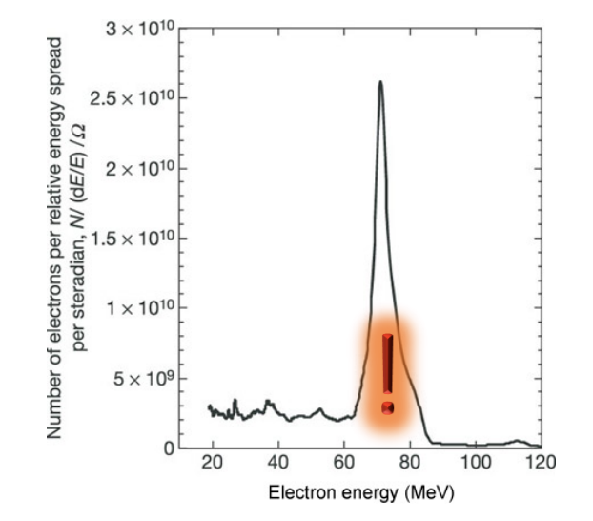
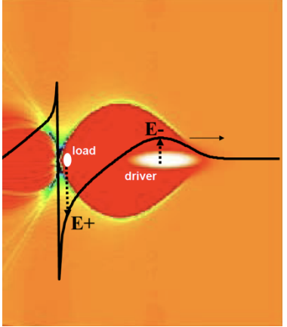
Nonlinear Regime
Dream beam is created using nonlinear regime, 2004.
Few percent energy spread is achieved!

Slide 13
Laser system
~ Peta watt laser is common in latest laser-plasma accelerator. Bella laser below.

Slide 14
Beam Driven PWA

Slide 15
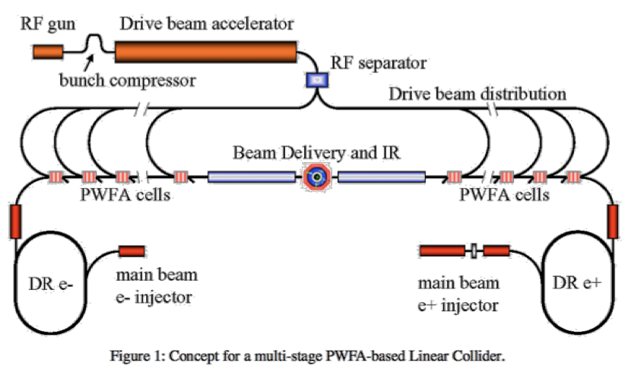
Larger Scale PWA

Slide 16
Dielectric Laser Acceleration
General Idea:
Scale down the Acc. Structure
Laser + Dielectrics
High rep rate, High field
High breakdown field
Mature fabrication process
@ R. J. England

Slide 17
Experiment Verification
Peralta, E. A., et al., 2013, Nature (London) 503, 91.

Slide 18
New Applications

Slide 19
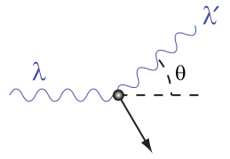
Compton Scattering
Compton scattering can be used to build compact X-ray source
We start with the rest frame of electron:
Compton
wavelength
Quantum correction of the Thomson scattering.

Slide 20
Doppler effect
Transform from the rest frame to the lab frame.
With the ‘back scattering’, i.e. the scattered angle is ~Pi, the wavelength relation in lab frame reads:
The energy ratio:

Slide 21
Cross Section
The cross section of the Thomson scattering is:
The Klein-Nishina formula gives
Where P is the ratio of the photon energy before and after collision. When the electron energy is much larger, the formula reduces to Thomson case.

Slide 22
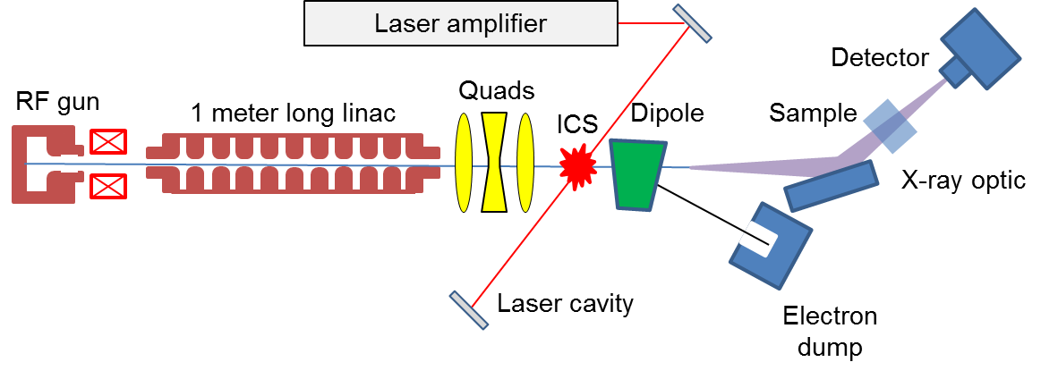
Example, a compact x-ray source
Proposed by W. Graves

Slide 23
Medical Application

Slide 24
Medical Application around World

Slide 25
Quantum Computing ?!
We need individual control qubits which can be in two base states:
and its linear combination and entangled states.
Ion trap
It is important to ensure the decoherence time of the Quantum state, while keep the strong coupling to the states to realized the ‘logic gate‘.
The decoherence time is largely improved in cQED from ns level to ms level in recent years, taking advantage of the high quality factor of the superconducting cavity, working at 10-20 mK.
Cavity Quantum ElectroDynamics (cQED)
2012 Nobel Prize

